Slide 1

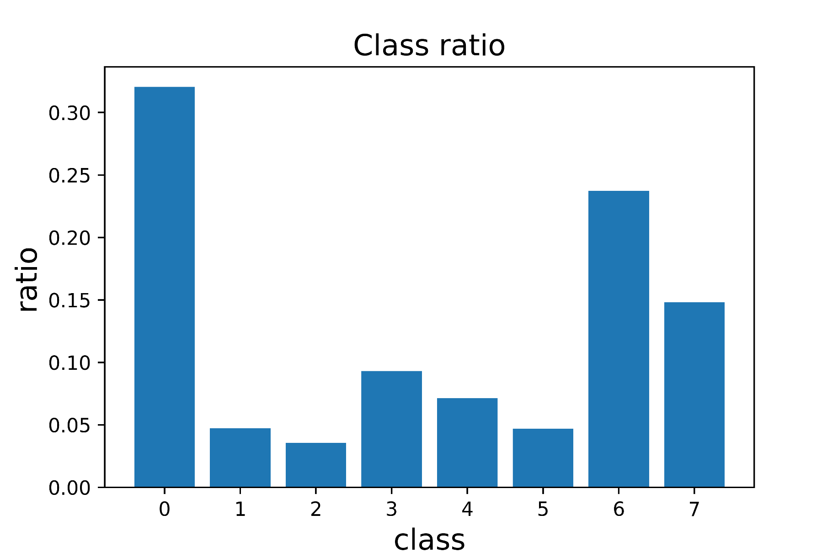
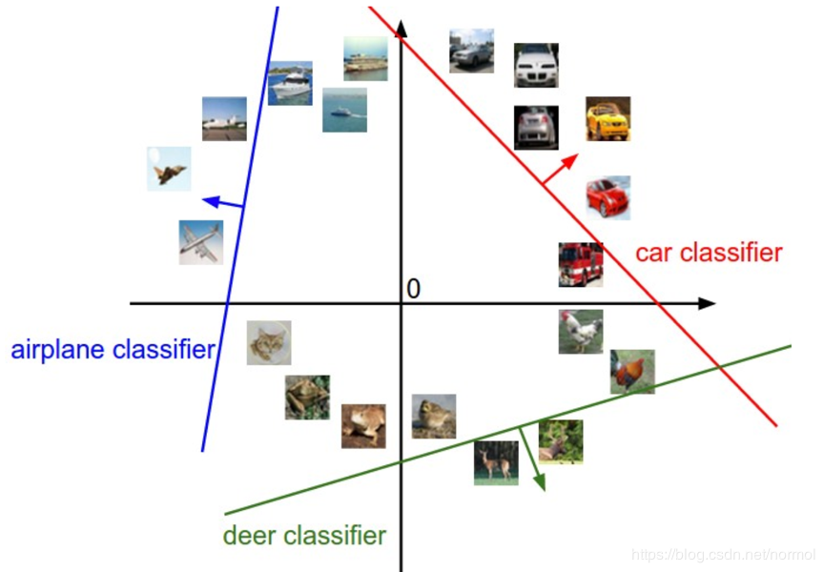
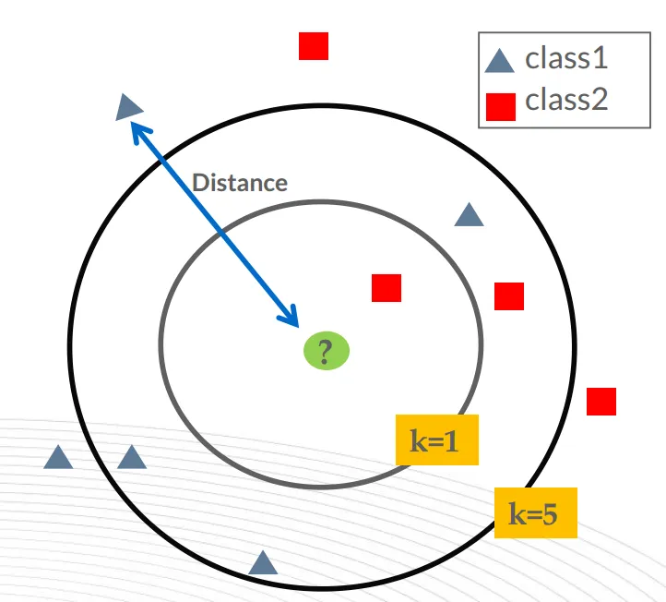
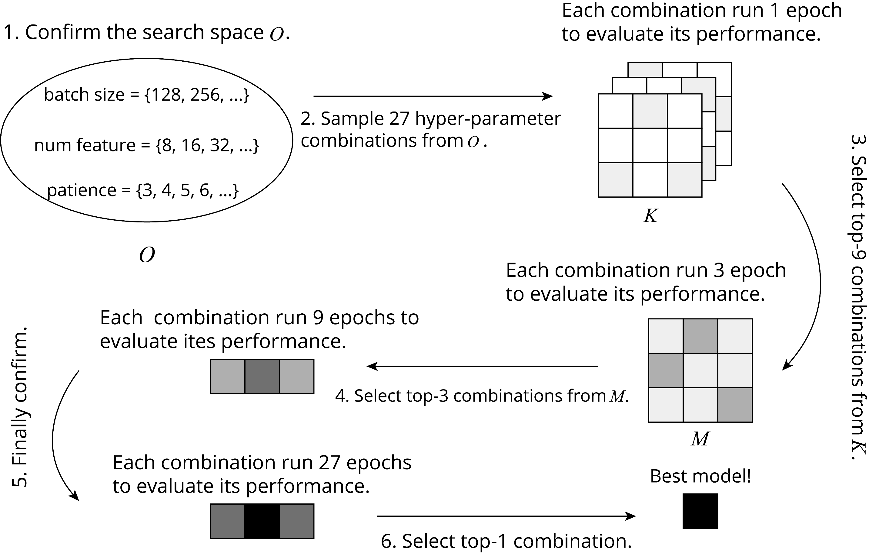
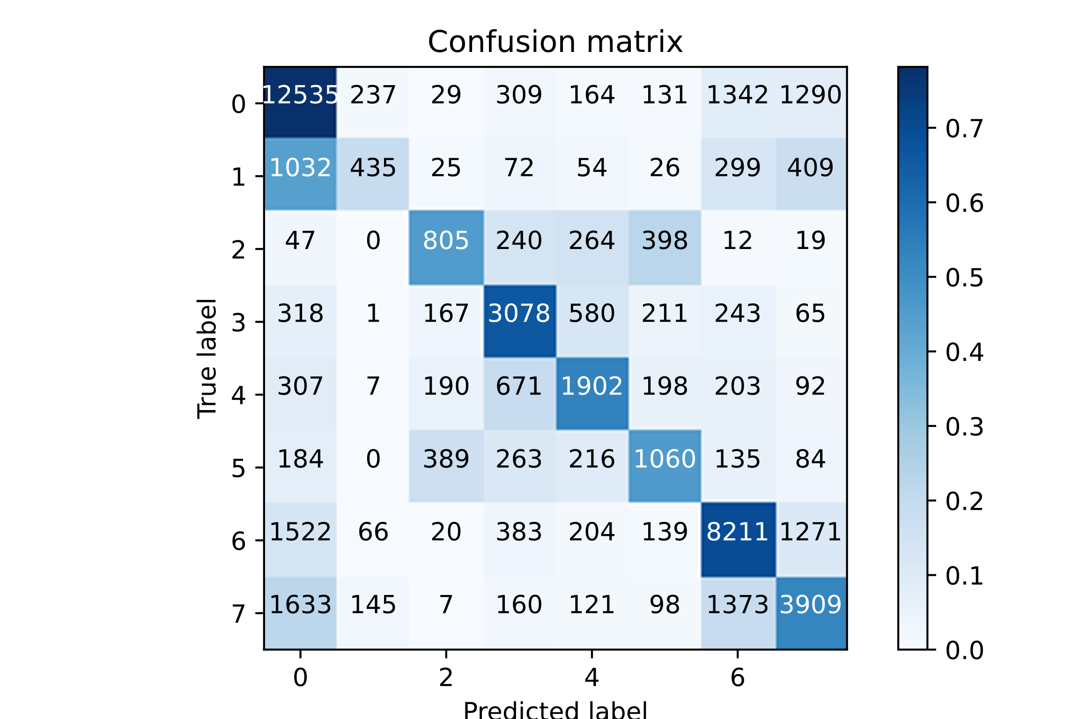
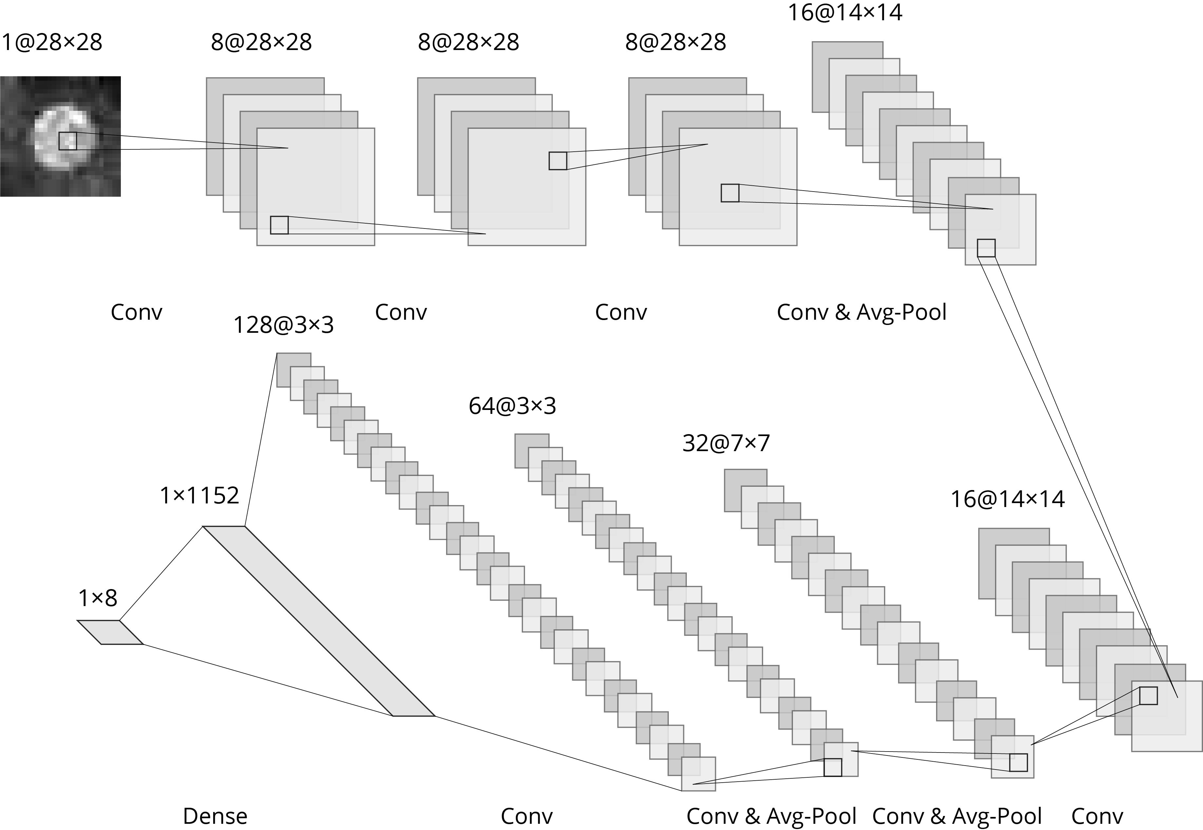
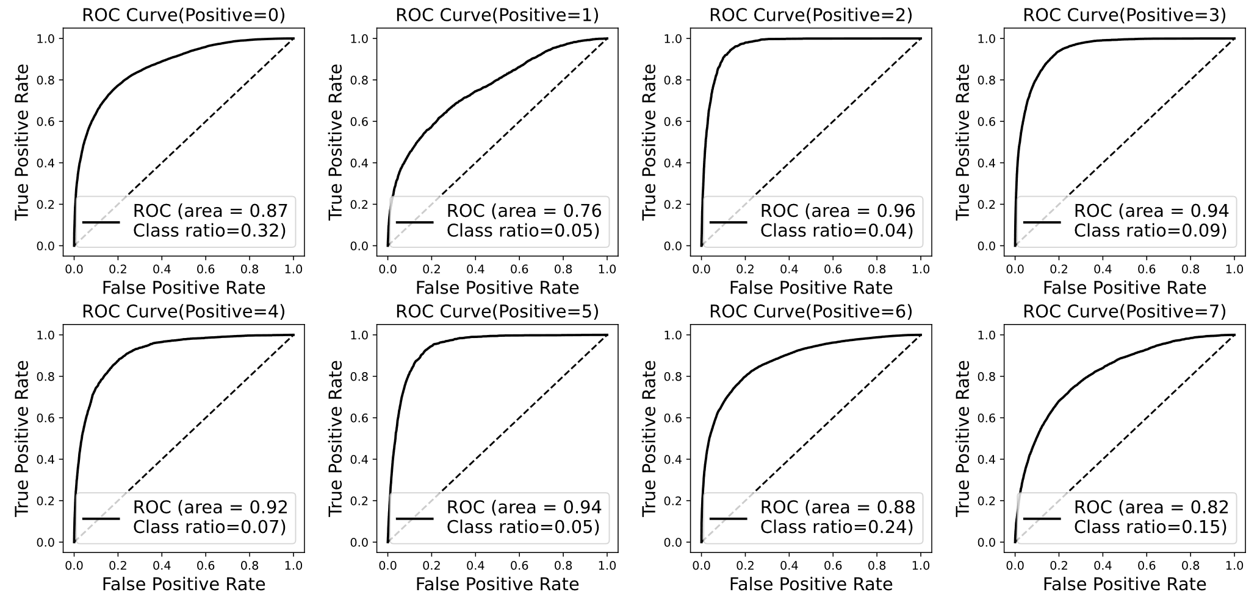
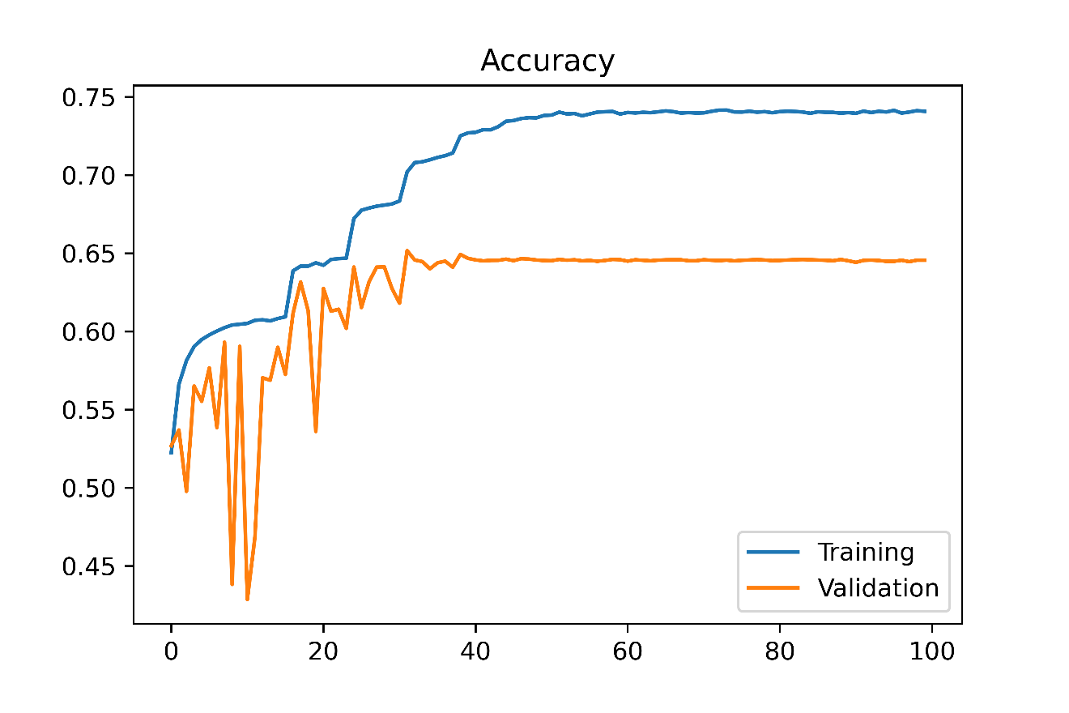
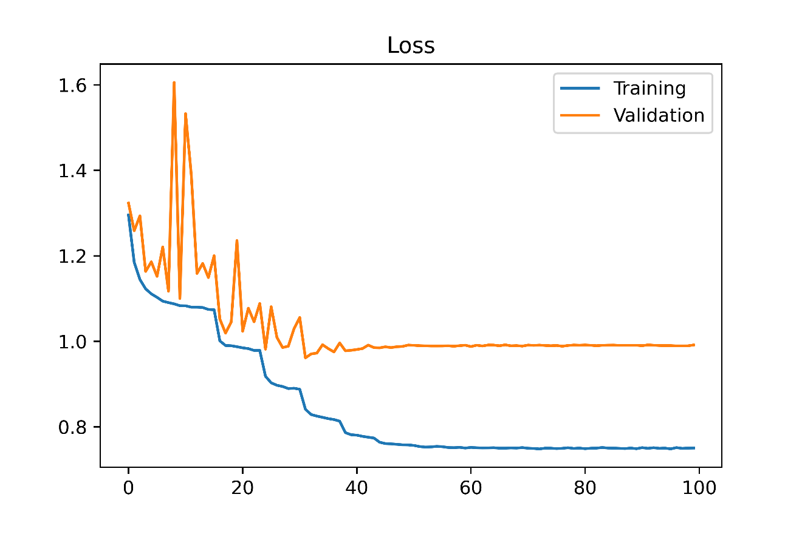
Medical Image Classification Model Based on CNN
Wei Deng, Kang Zhu
Beijing University of Posts and Telecommunications
Image Classification
The Trick of Hyperparameter Optimization
Testing Results
Image classification is one of the basic research topics in the field of artificial intelligence. There are many classical image classification algorithms:
KNN
SVM
In order to improve the efficiency of hyperparameters adjustment, we utilize an automatic hyperparameters regulator based on Hyperband Algorithm[2]. It works as the following flow:
Metric | Result
Accuracy | 0.6387
F1-Score | 0.5426
Recall | 0.5356
Precision | 0.5678
Limitation of KNN&SVM:
KNN has a large amount of computation and memory overhead
SVM performance mainly depends on the selection of kernel function, and doesn’t suitable for large-scale training samples
For each class, regard itself as positive and others negative
Compute macro-average of F1-Score, recall and precision to evaluate the whole performance
For each class, illustrate the ROC curve and compute AUC
Medical Image Classification Model Based on CNN
In image classification tasks, CNN is a benchmark method. Andre Woloshuk[1], based on CNN, proposes a convolutional neural network called NephNet2D, which performs well in medical image classification.
With the automated hyperparameter regulator, we can:
Make hyperparameter selection adjustments within the range we expect
Under the condition of limitated number of iterations, find the satisfactory hyperparameters
Based on NephNet2D, we proposed a medical image classification model.
Experimental Environment and Setup
PyTorch deep-learning framework
Apex library for mix precision training to accelerate the training and reduce memory usage
Using a subset of the whole dataset(10,000 samples) for adjusting the model roughly
80%(120,000) of dataset for training and 20%(30, 000) of dataset for validation. Test dataset contains 50,000 pieces of data.
Scikit-learn library for metric computing
Optimizer: SGD with momentum=0.8
Batch size: 128
Weight decay: 0.004
Initial learning rate: 0.025
Dropout rate: 0.5
Learning rate scheduler: Reduce learning rate when validation metric stopped improving, with hyperparameter patience=5 and factor=0.29.
Training Results
Reference
Filter: size=3×3, stride=1, padding=1
Average pooling: size=2×2, stride=2
2D-Batch normalization is used
Activation: ReLU
Dropout is used
[1] A. Woloshuk et al. In situ classification of cell types in human kidney tissue using 3dnuclear staining.Cytometry Part A, 99(7):707–721, 2021
[2] Lisha Li∗, Kevin Jamieson∗∗, Giulia DeSalvo†, et al. Hyperband: Bandit-Based Configuration Evaluation for Hyperparameter Optimization.

